Slide 1



PROJECT MANAGEMENT IN PRACTICE
Project Cost Management
Lecture No: 8 Week: 4
Vispi Shroff
Sub Heading
And Date

Slide 2

Recap
Resource Estimation and Project Schedule
Optimisation Techniques
Critical Path Analysis
PERT (Program Evaluation and Review Technique)
Schedule Control

Slide 3
Today’s Topics & Learning Outcomes
Importance of Cost Management
Cost Management Principles and concepts
Cost Estimation
Project Budgets
Earned Value Management
Benefits of Portfolio Management

Slide 4
What is Cost and Project Cost Management?
- Cost is a resource sacrificed or foregone to achieve a specific objective or something given up in exchange
- Costs are usually measured in monetary units like euro or dollars
- Project cost management includes the processes required to ensure that the project is completed within an approved budget
- Estimating costs: developing an approximation or estimate of the costs of the resources needed to complete a project
- Determining the budget: allocating the overall cost estimate to individual work items to establish a baseline for measuring performance
- Controlling costs: controlling changes to the project budget

Slide 5
Basic Principles of Cost Management
- Tangible costs or benefits are those costs or benefits that an organization can easily measure in dollars
- Intangible costs or benefits are costs or benefits that are difficult to measure in monetary terms
- Direct costs are costs that can be directly related to producing the products and services of the project
- Indirect costs are costs that are not directly related to the products or services of the project, but are indirectly related to performing the project
- Sunk cost is money that has been spent in the past; when deciding what projects to invest in or continue, you should not include sunk costs

Slide 6
Estimating Costs & Cost Management Plan
- Project managers must take cost estimates seriously if they want to complete projects within budget constraints
- It’s important to know the types of cost estimates, how to prepare cost estimates, and typical problems associated with IT cost estimates
- A cost management plan is a document that describes how the organization will manage cost variances on the project
- A large percentage of total project costs are often labor costs, so project managers must develop and track estimates for labor

Slide 7
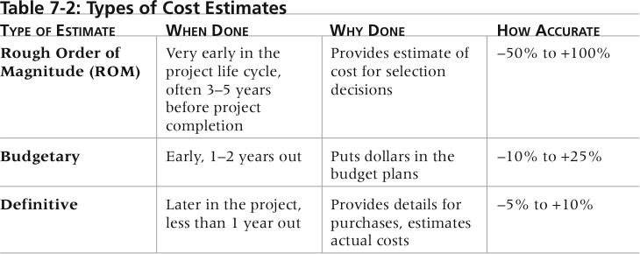
Types of Cost Estimates

Slide 8
Cost Estimation Tools and Techniques
Basic tools and techniques for cost estimates:
Analogous or top-down estimates: use the actual cost of a previous, similar project as the basis for estimating the cost of the current project
Bottom-up estimates: involve estimating individual work items or activities and summing them to get a project total
Parametric modeling uses project characteristics (parameters) in a mathematical model to estimate project costs
Three-Point Estimates: involve using optimistic, most likely and pessimistic estimates.

Slide 9
Typical Problems with IT Cost Estimates
- Estimates are done too quickly
- Lack of estimating experience
- Human beings are biased toward underestimation
- Management desires accuracy

Slide 10
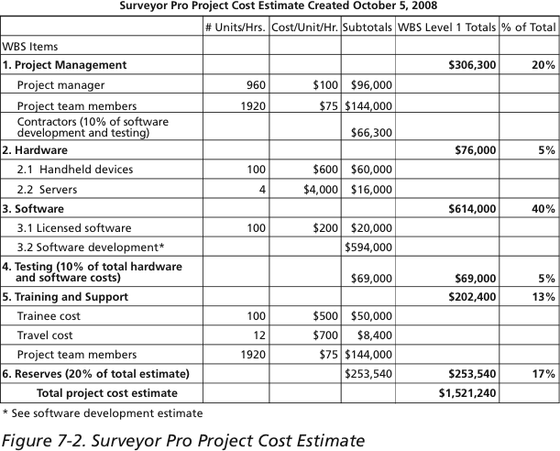

Slide 11
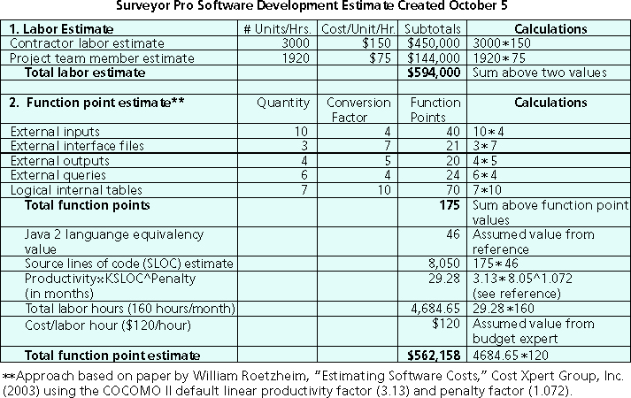

Slide 12
Determining the Budget
- Cost budgeting involves allocating the project cost estimate to individual work items over time
- The WBS is a required input to the cost budgeting process since it defines the work items
- Important goal is to produce a cost baseline
- A time-phased budget that project managers use to measure and monitor cost performance

Slide 13
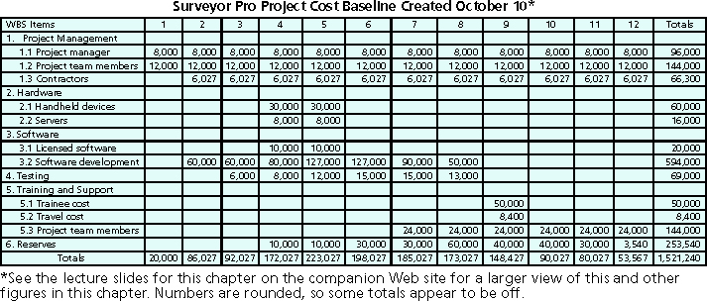

Slide 14
Earned Value Management
- EVM is a project performance measurement technique that integrates scope, time, and cost data
- Given a baseline (original plan plus approved changes), you can determine how well the project is meeting its goals
- You must enter actual information periodically to use EVM
- More and more organizations around the world are using EVM to help control project costs

Slide 15
EVM Terms
- The planned value (PV), aka budgeted cost of work scheduled (BCWS), also called the budget, is that portion of the approved total cost estimate planned to be spent on an activity during a given period
Actual cost (AC), aka actual cost of work performed (ACWP), is the total of direct and indirect costs incurred in accomplishing work on an activity during a given period
The earned value (EV), aka the budgeted cost of work performed (BCWP), is an estimate of the value of the physical work actually completed
EV is based on the original planned costs for the project or activity and the rate at which the team is completing work on the project or activity to date

Slide 16
Rate of Performance
Rate of performance (RP) is the ratio of actual work completed to the percentage of work planned to have been completed at any given time during the life of the project or activity
For example, suppose the server installation was halfway completed by the end of week 1: the rate of performance would be 50% because by the end of week 1, the planned schedule reflects that the task should be 100 percent complete and only 50 percent of that work has been completed

Slide 17
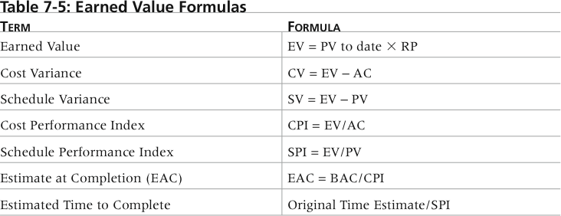
Earned Value Formulae

Slide 18
An Example…
The development of a software module.
The budget or Planned Value(PV) is €5000
The Actual Cost (AC) is €15000
The Rate of Performance is 50%
Calculate the required metrics to carry out Earn Value Management as a form of project cost management.

Slide 19
EVM Rules of Thumb
- Negative numbers for cost and schedule variance indicate problems in those areas
- CPI and SPI less than 100% indicate problems
- Problems mean the project is costing more than planned (over budget) or taking longer than planned (behind schedule)
- The CPI can be used to calculate the estimate at completion (EAC), an estimate of what it will cost to complete the project based on performance to date; the budget at completion (BAC) is the original total budget for the project

Slide 20
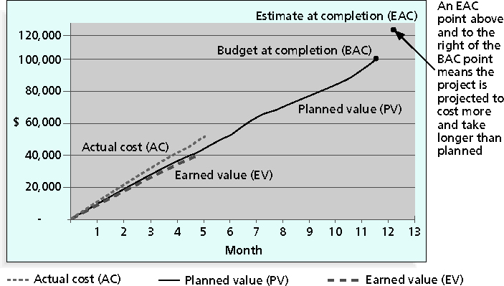
EV Chart for Project after 5 months

Slide 21
Project Portfolio Management
Many organizations collect and control an entire suite of projects or investments as one set of interrelated activities in a portfolio
Five levels for project portfolio management
Put all your projects in one database
Prioritize the projects in your database
Divide your projects into two or three budgets based on type of investment
Automate the repository
Apply modern portfolio theory, including risk-return tools that map project risk on a curve

Slide 22
Benefits of Portfolio Management
ROI of implementing portfolio management software by IT departments:
Savings of 6.5 percent of the average annual IT budget by the end of year one
Improved annual average project timeliness by 45.2 percent
Reduced IT management time spent on project status reporting by 43 percent and IT labor capitalization reporting by 55 percent
Decreased the time to achieve financial sign-off for new IT projects by 20.4 percent, or 8.4 days

Slide 23
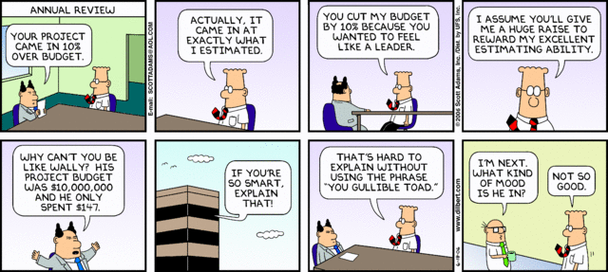
Any Thoughts, Questions, Ideas?

Slide 24
Reading Materials for the Week
Schwalbe, K.. 2007 – Information Technology Project Management, Chapter 7 & 8
PMBOK Guide, 4th Ed – Chapter 7 & 8

Slide 25
Conclusions
We’ve looked at
Cost Estimation
Project Budgets
Earned Value Management and its benefits

Slide 26
References
Schwalbe, K.. 2007 – Information Technology Project Management, Chapter 7
PMBOK Guide, 4th Ed – Chapter 7

